Slide 1

How to Download the Telus Health App
Jan 2024

Slide 2

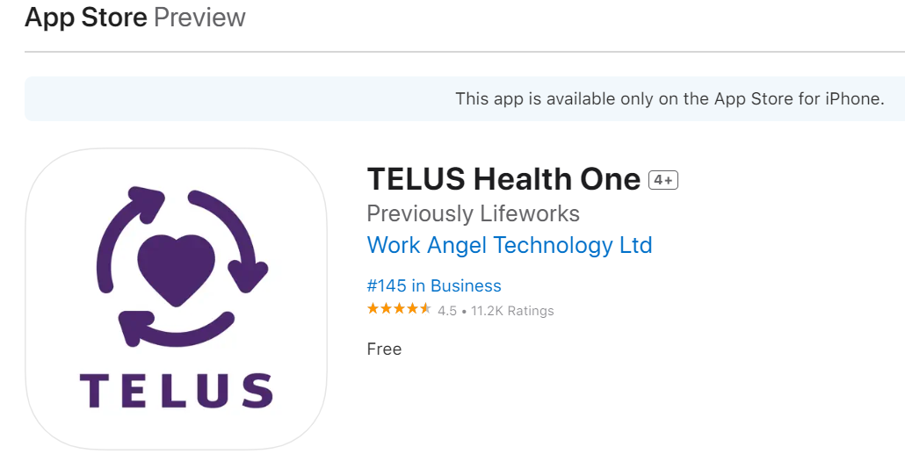

How to Download the Mobile App
For Apple Phone/Devices, you will need to go to the App Store to download the TELUS Health App
For Android Devices, you will need to go to Goggle Play Store to download the TELUS Health App

Slide 3
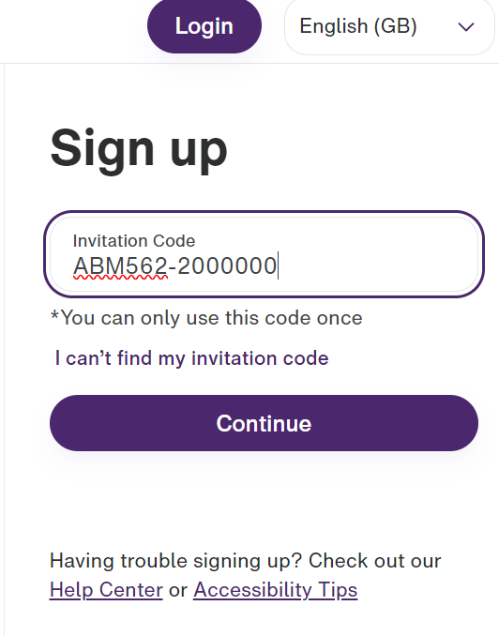
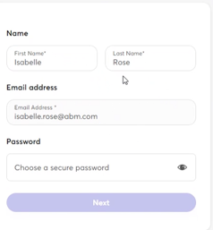
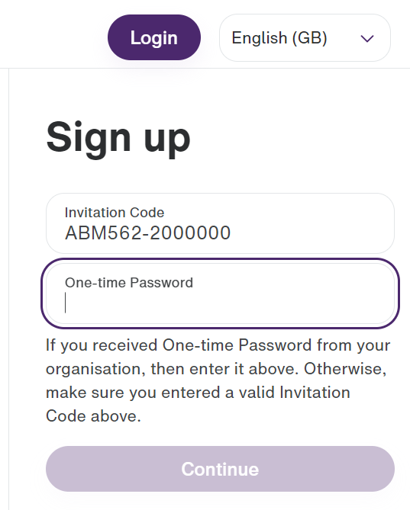
How to Register to TELUS Health using your Work Email Address
4
Step 4: Select ‘Continue’
Step 5: Create your TELUS Health Account adding:
First Name
Last Name
Add a new password
Step 6: Select ‘Next’
Step 7: Review and Read the Privacy information –
confirm and accept terms and conditions
Step 8: Select ‘Sign up’
Team Members with ABM email accounts will receive a sign-up email from TELUS Health.
Step 1: Your invitation code will automatically be populated
Step 2: Select ‘Continue’
Step 3: Enter your One Time Password, which is your Home Postcode, all Upper Cases and no spaces
5
1
2
6
3
7
8

Slide 4
How to Register to TELUS Health using your TMG Person Number
5
1
Step 5: Select ‘Continue’
Step 6: Create your TELUS Health Account adding:
First Name
Last Name
Add a new password
Step 7: Select ‘Next’
Step 8: Review and Read the Privacy information –
confirm and accept terms and conditions
Step 9: Select ‘Sign up’
Step 1: Click here to go to the website
Step 2: Go to ‘Sign Up’ and add the following:
ABM562-(your TMG person number) no spaces
Step 3: Select ‘Continue’
Step 4: Enter your One Time Password, which is your Home Postcode, all Upper Cases and no spaces
6
2
3
7
4
8
9

Slide 5
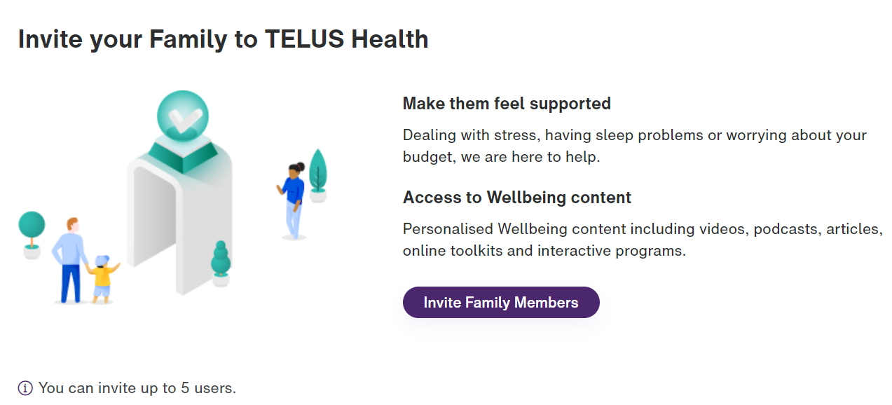
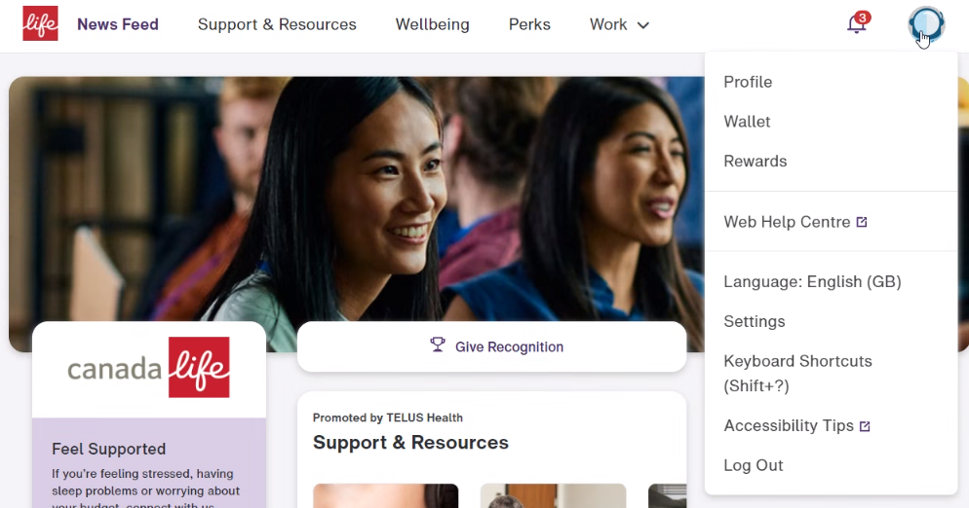
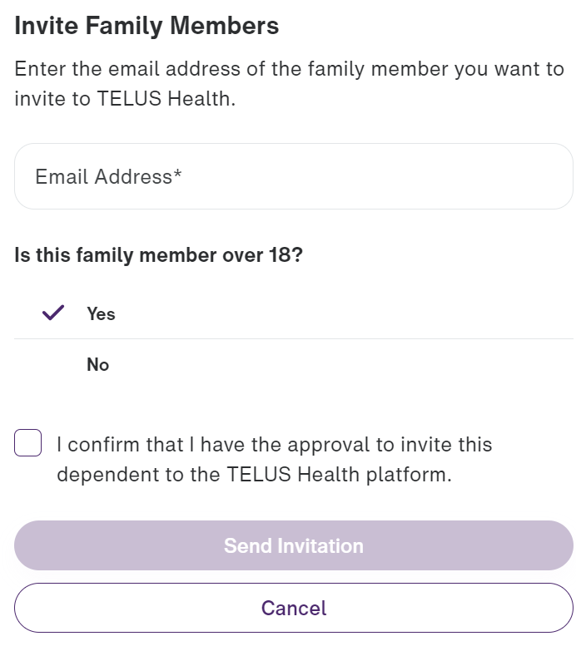
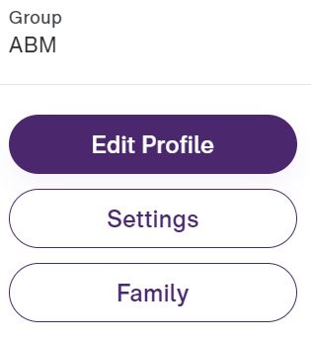
How to Add Friends and Family to TELUS Health
4
1
Step 4: Select ‘Invite Family Members’
Step 5: Add The following:
Family member personal email address
Confirm you have approval for invite
Family members must be over 18 years of age
Step 6: Select ‘Send Invitation’
Step 1: Login to TELUS Health
Step 2: Click on the ‘Mirror Icon’ and select ‘Profile’
Step 3: Select ‘Family’
2
5
3
6

Slide 6
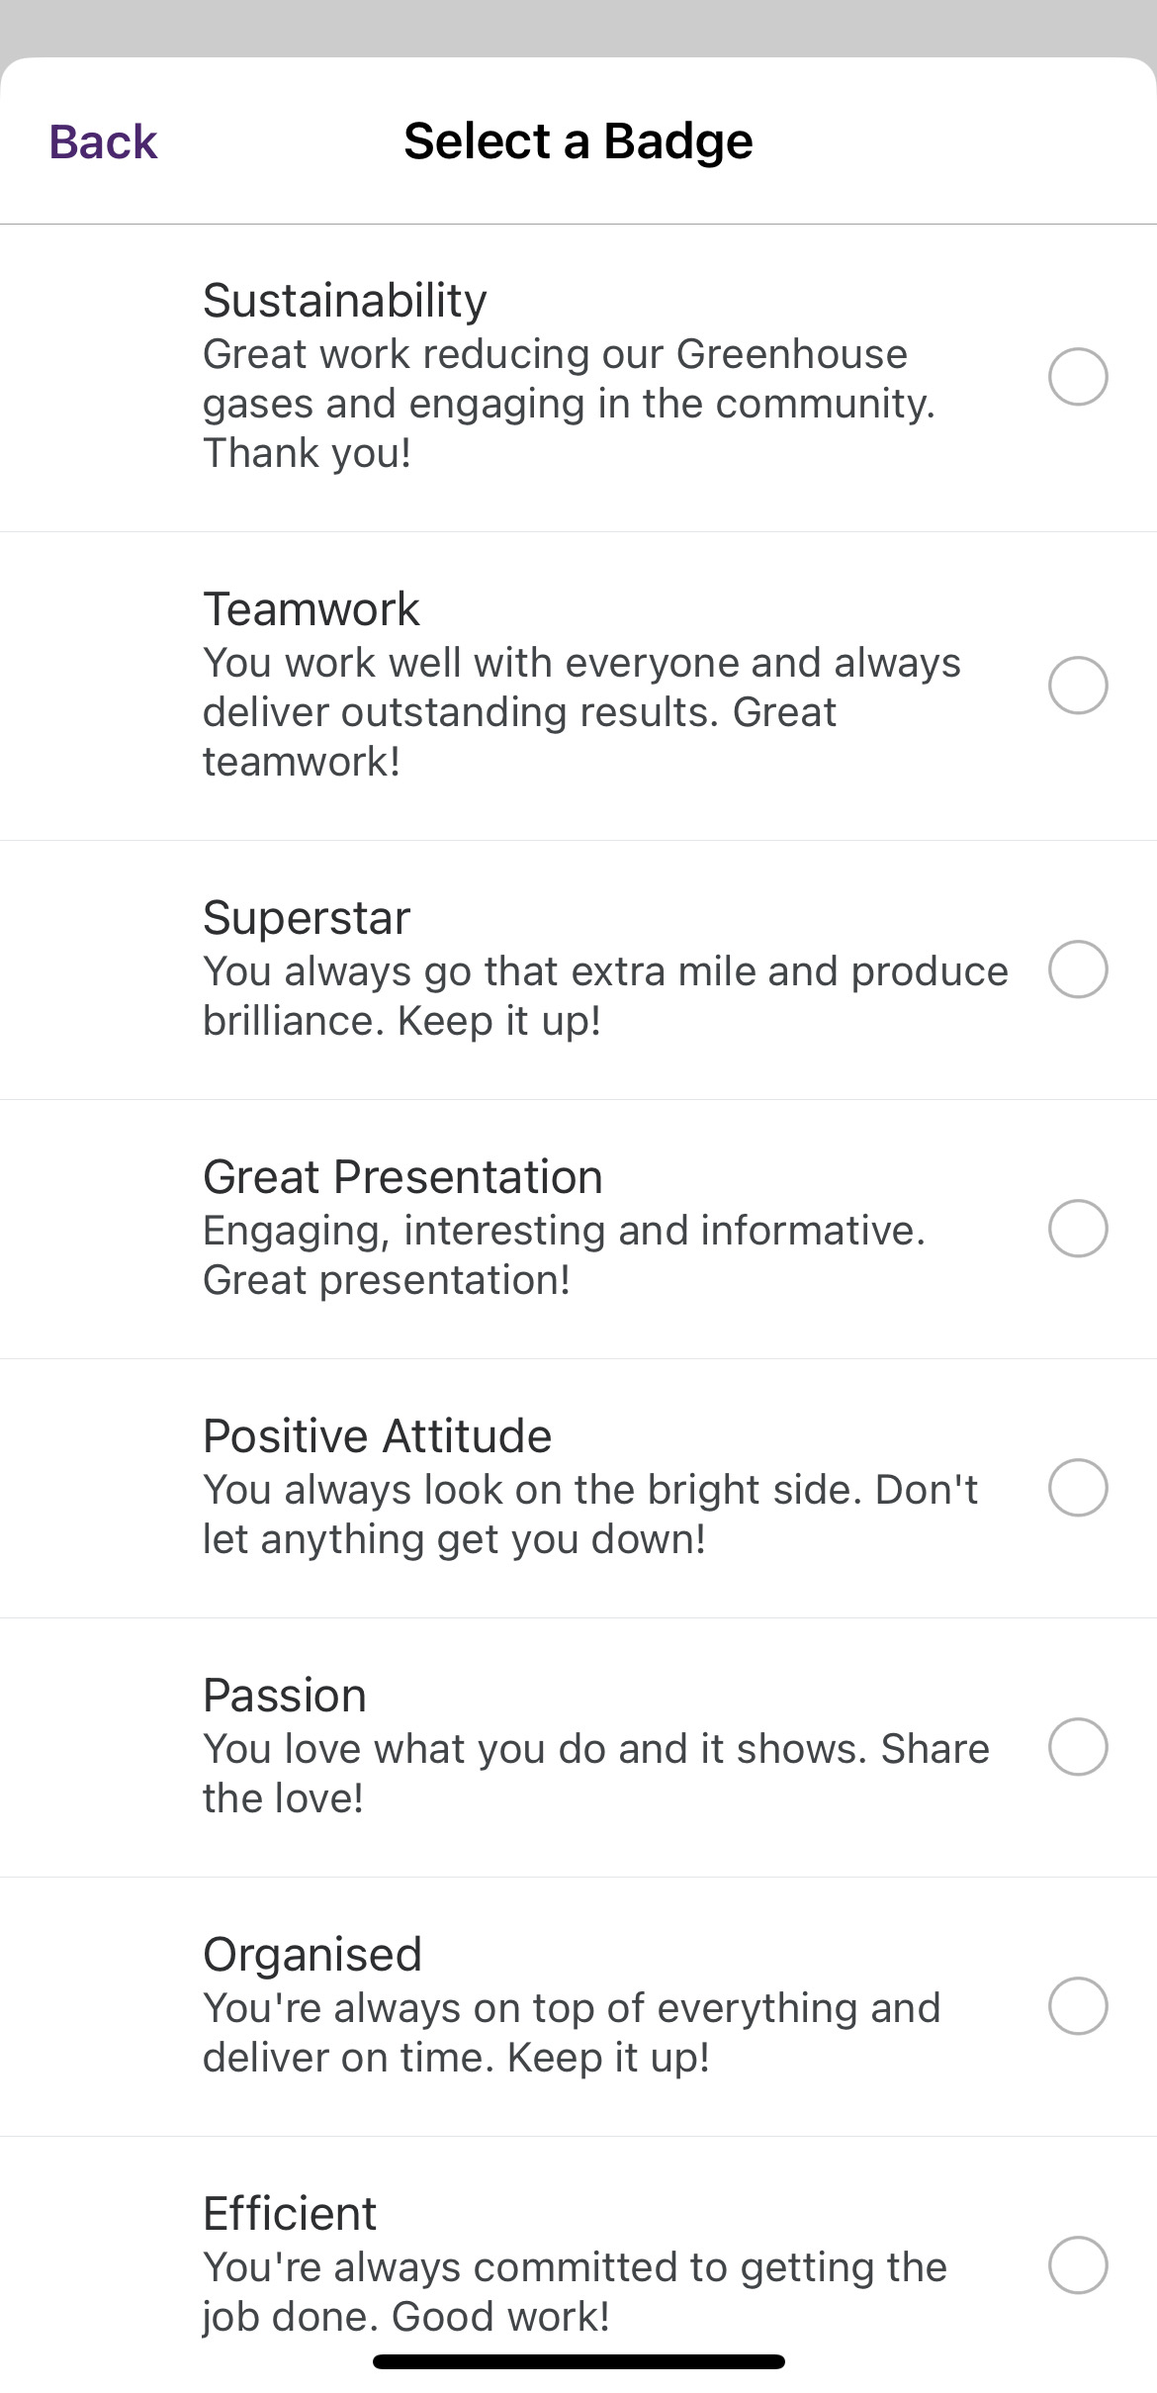
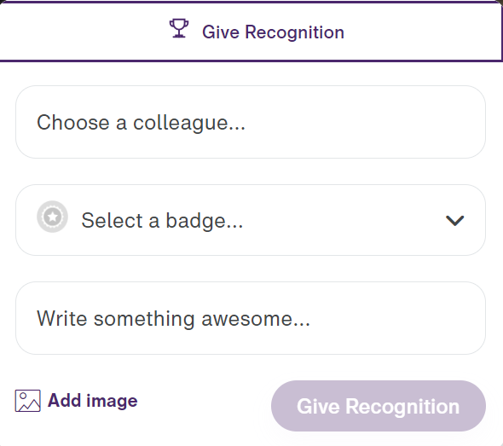
How to Give Recognition to Colleagues
1
4
Step 1: Login to TELUS Health
Step 2: On your Home Page go to ‘Give Recognition’
Step 3: Search colleague name that you would like to recognise
Step 4: Select the Badge for recognition:
Step 5: Write a comment for your colleague
Step 6: Select ‘Give Recognition’
2
5
6
3

